Slide 1
Loyalty Card System
Initial proposal

Slide 2
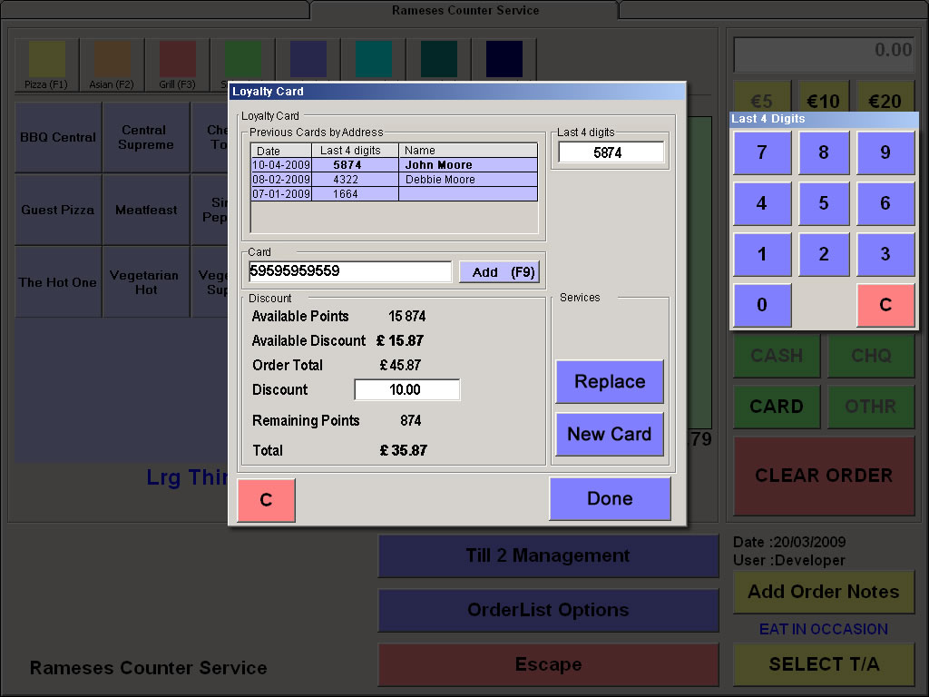
Rameses Integration

Slide 3
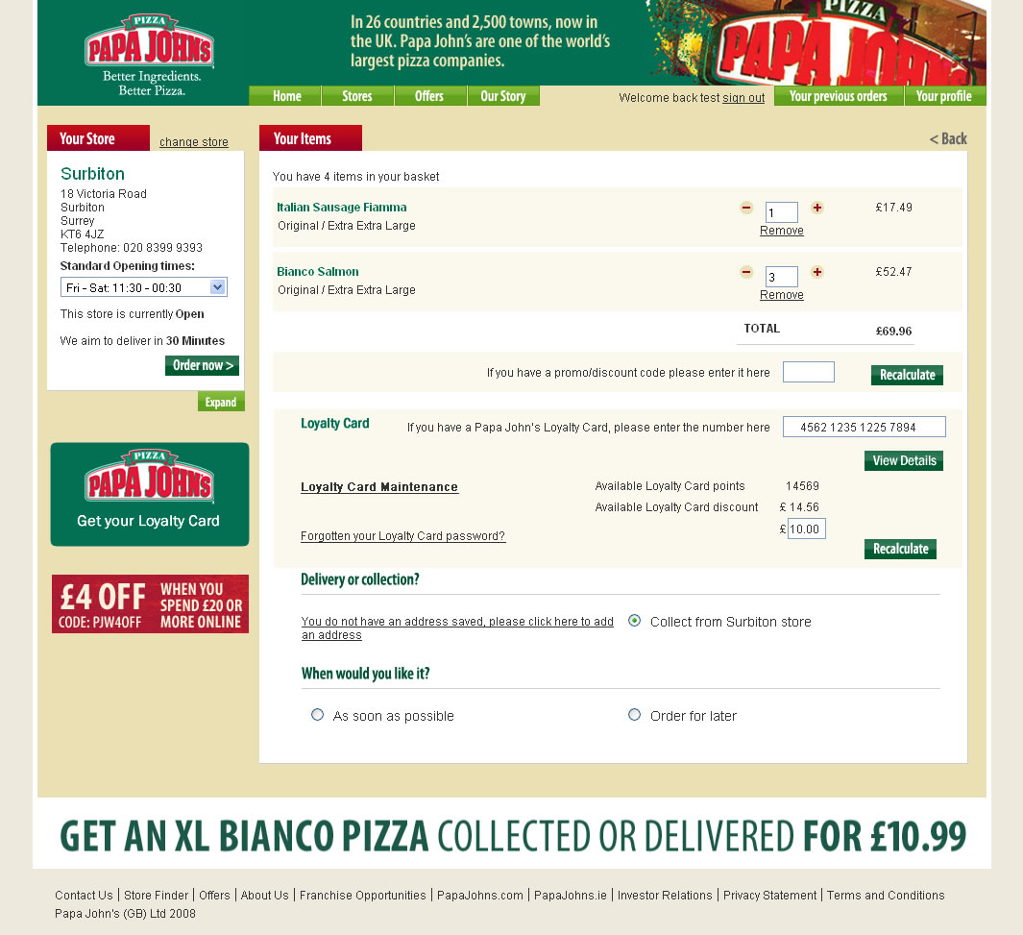
Website Integration

Slide 4
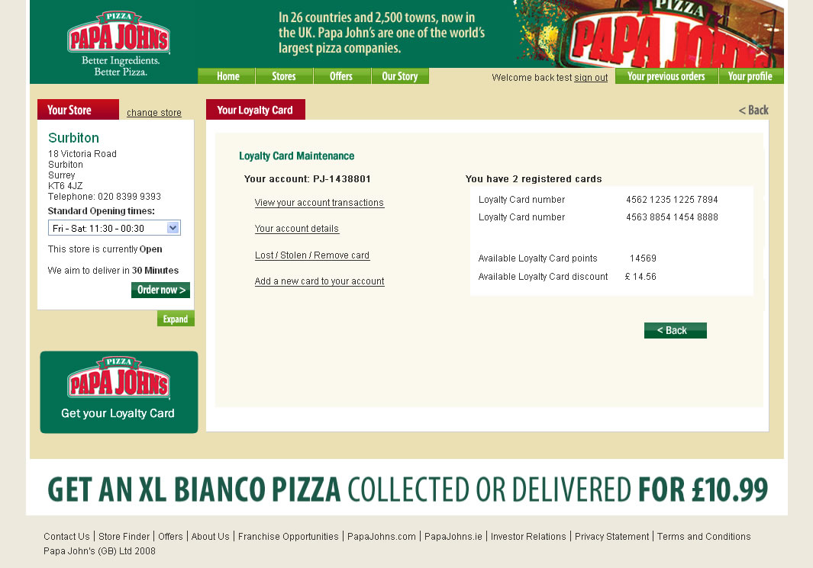
Website Integration

Slide 5
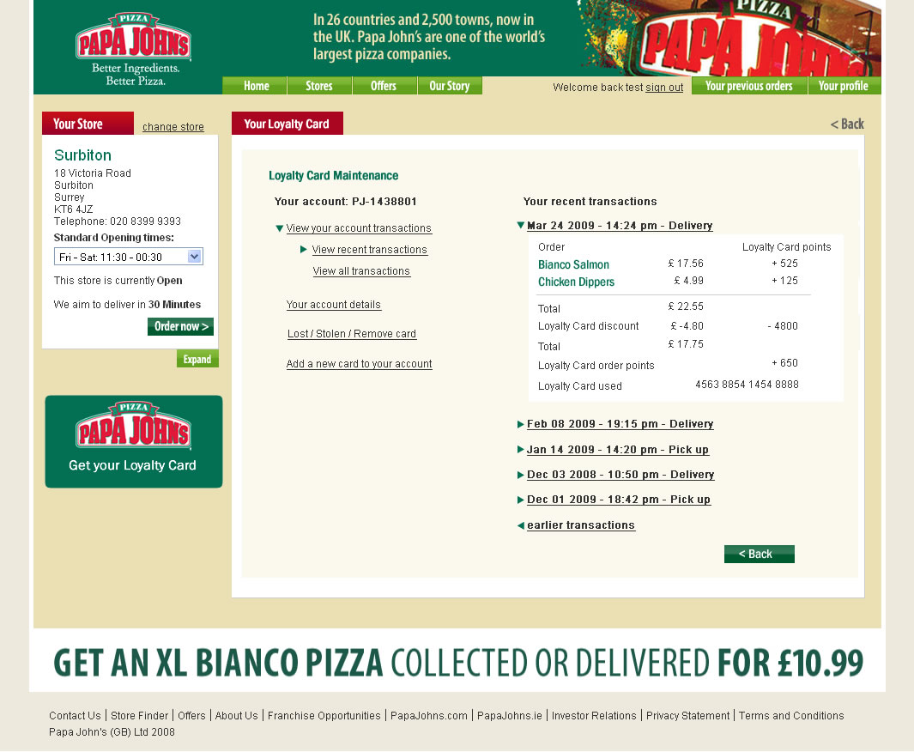
Website Integration

Slide 6
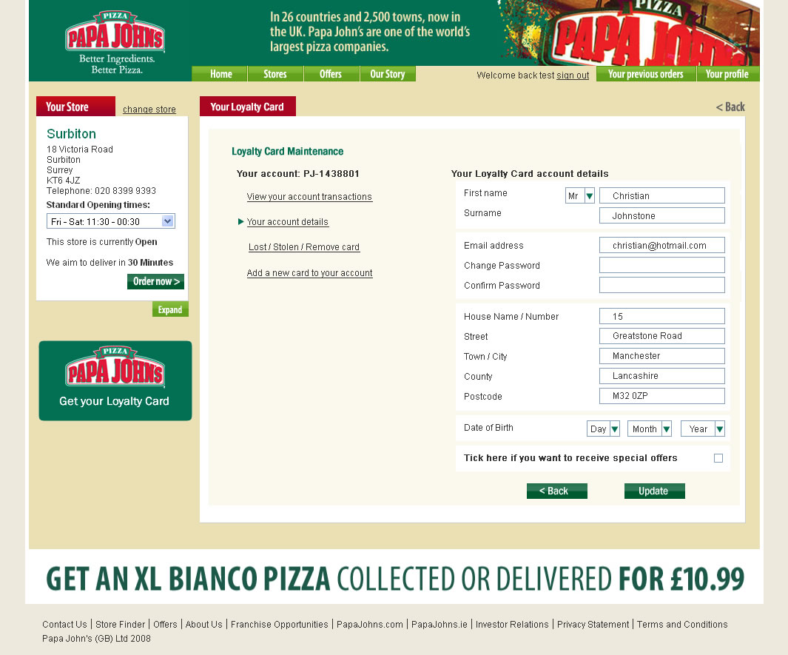
Website Integration

Slide 7
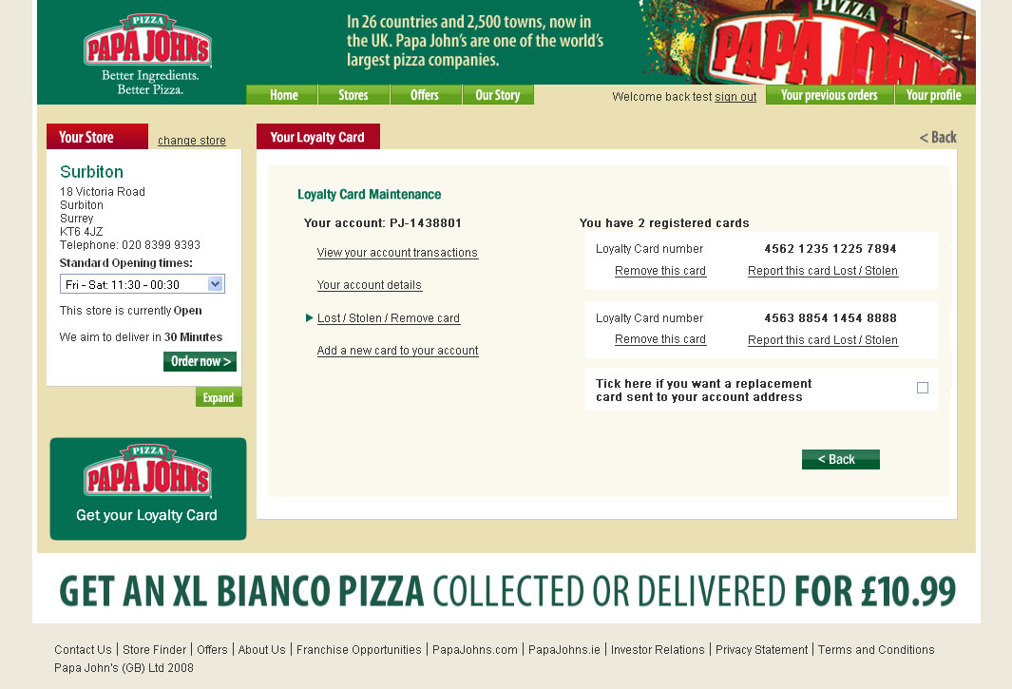
Website Integration

Slide 8
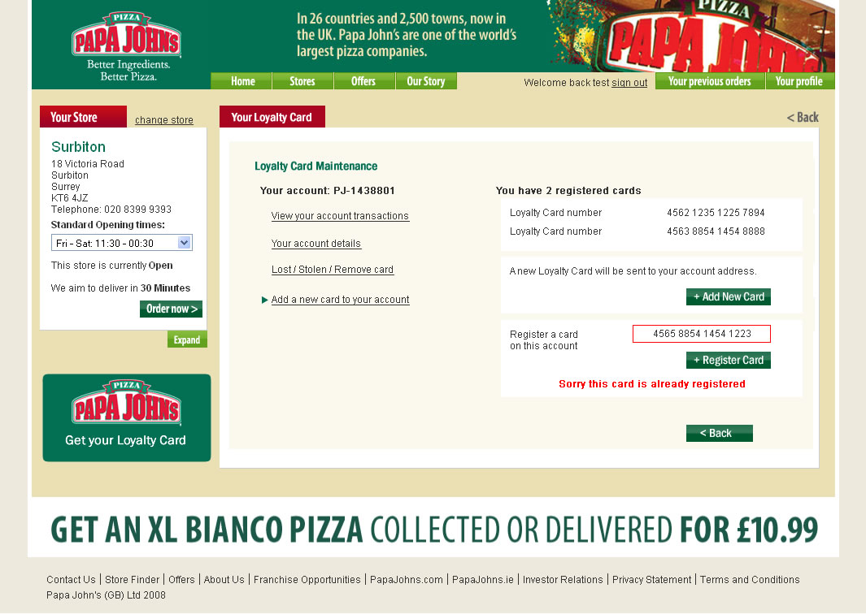
Website Integration

